Slide 1
OO Analysis
CCP 6224
Object-oriented Analysis and Design
Lecture 05-06

Slide 2
Lecture outcomes
At the end of this lecture, you are expected to
  understand how OO paradigms are applied to software project development
  know how requirements of a project are modeled using Analysis Object Model (AOM) and dynamic models
Portions of this file have content sourced from www.lloseng.com

Slide 3
Software : Definition
Software is everything in a computer system that is not hardware; mainly the instructions, data, and object interactions that make the system work.
Software is a structured collection of programs, data, and object-based models designed to fulfill user and system requirements.
(Definition in OOAD context)
Software is an organized set of programs, data, and models that work together to perform tasks and solve problems.
It includes the application logic, system behavior, and the structures that define how objects interact to meet user requirements.

Slide 4
The nature of software
Software :-
  Is intangible : hard to quantify and difficult to understand development effort required
  Is easy to reproduce : compared to other outputs (e.g. manufacturing) cost is purely in development
  Is labour-intensive : hardly ever automated, mostly custom
  Quality is difficult to maintain: multiple people working together will generate different levels of software quality
  Is easy to modify : changes are made without understanding the problem
  Never wears out : unlike a physical item, software will not deteriorate until its functionality is changed or is outdated
Much software has poor design and is getting worse whilst the high demand for software continues to rise
People should learn how to ‘engineer’ and not ‘write’ software

Slide 5
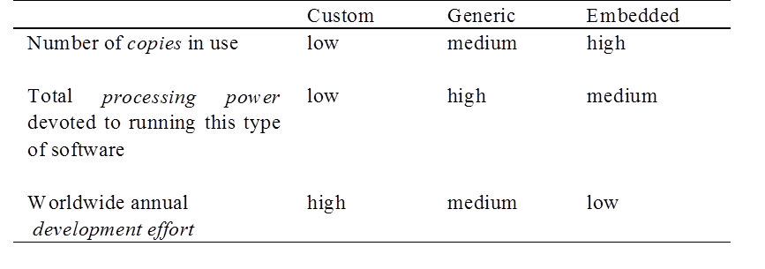
Types of Software
Custom - for a specific customer
Generic
  Sold on open market for ready use
    COTS (Commercial Off The Shelf)
    Shrink-wrapped
Embedded - Built into hardware and hard to change
Differences :-

Slide 6
Software engineering?
The process of solving customers’ problems by the systematic development and evolution of large, high-quality software systems within cost, time and other constrain
Solving customers’ problems – the goal of software engineering
  adding unnecessary features may not solve the problem, often times the solution is to buy and not build
  Systematic development and evolution - involves applying well understood techniques in a organized and disciplined way
Large, high quality software systems – many systems cannot be completely understood by one person
  Teamwork and co-ordination are required so the challenge is dividing the work and ensuring the parts work properly together
Cost, time and other constraints – is bounded by finite resources
  Inaccurate estimates of cost and time have caused many project failures

Slide 7



OO software development
OO represents one of many methods that can be applied in software engineering to formulate a structured plan to solve a software related problem.
As opposed to thinking what functions the system needs, it looks at what objects are required instead and what responsibilities each object possesses.
TRADITIONAL
PROGRAMMING
OBJECT ORIENTED
PROGRAMMING
focuses on operations (i.e. withdraw, deposit, transfer)
focuses on objects (i.e. customer, account, branch)

Slide 8
Why OO?
While developing using OO paradigm, developers/engineers should take advantage of the reusability aspects of an OO language
Avoid re-developing software already developed
Types of reuse:
  Reuse of expertise (developer/engineer/designer)
  Reuse of standard designs and algorithms
  Reuse of libraries of classes or procedures
  Reuse of powerful commands built into languages and/or operating systems
  Reuse of frameworks and design patterns
  Reuse of complete applications
Reuse AND design for reusability should be part of the culture of software development organizations

Slide 9
Types of software projects
Many projects are evolutionary or maintenance projects, involving work on legacy systems
  Corrective projects: fixing defects
  Adaptive projects: changing the system in response to changes in operating system, database, business rules and regulations etc.
  Enhancement projects: adding new features for users
  Re-engineering or perfective projects: changing the system internally so it is more maintainable – functionally it works the same
‘Greenfield’ projects
  Totally new development
  The minority of projects
Greenfield projects
Brownfield projects

Slide 10
Activities in software projects
Typical requirements and specification navigates 6 phases including:
    [1] Domain analysis
    Requirements gathering - obtaining input from as many sources as possible to define the problem
    Requirements analysis - organizing the information
    Requirements specification - writing detailed instructions about how the software should behave
This phase will be covered in today’s lecture

Slide 11
[2] Design
  Deciding how the requirements should be implemented, using the available technology. Includes:
    Systems engineering: Deciding what should be in hardware and what in software
    Software architecture: Dividing the system into subsystems and deciding how the subsystems will interact
    Detailed design of the internals of a subsystem
    User interface and database design
[3] Modeling
  Creating representations of the domain or the software using UML diagrams
[4] Programming / prototyping / versioning
[5] Quality assurance
  Reviews and inspections
  Testing
[6] Deployment/Maintenance

Slide 12
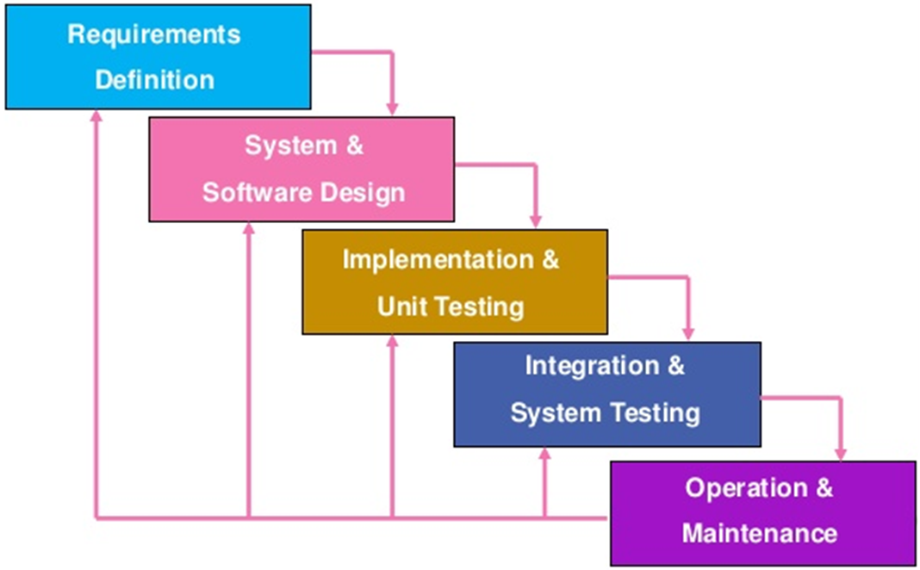
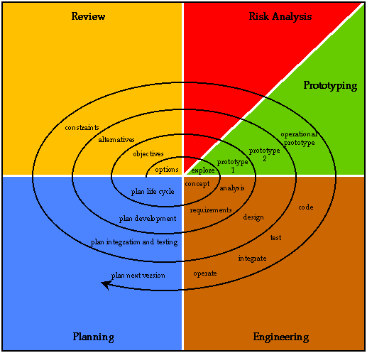
How does this map to design models?
A different course may cover content such as waterfall, V, spiral, Boehm etc.
These models (or methodologies) are generic and work with both traditional and OO development styles
OOAD is complementary to software design and is not meant to replace it

Slide 13
Domain analysis
The software engineer learns about the domain to better understand the problem
  The domain is the general field of business or technology in which the customer/clients will use the software
  A domain expert is a person who has a deep knowledge of the domain – usually a well-versed client or possible another software engineer!
Benefits of performing domain analysis:
    Faster development
    Better system (less errors)
    Anticipation of extensions (preparation for future)

Slide 14
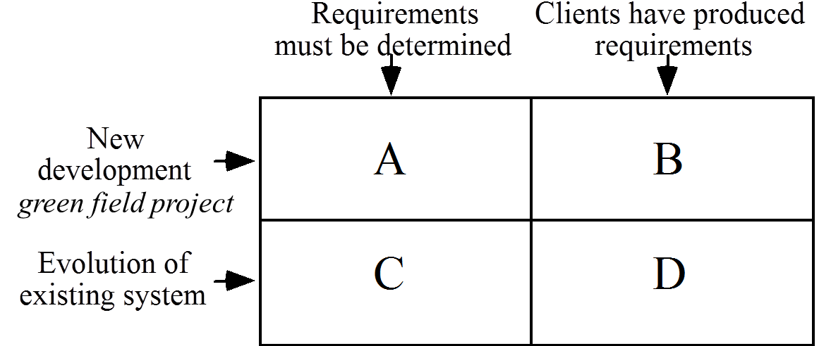
The starting point of software projects

Slide 15
Problem definition
A problem can be expressed as:
  A difficulty the users or customers are facing
  Or as an opportunity that will result in some benefit such as improved productivity or sales
The solution to the problem normally will entail developing software – that’s what we’re here for!
A good problem statement is short and succinct
It should be straight to the point and un-ambiguous
The definition should cover ONE (1) problem (or at least can treat multiple smaller ones and one large one) – else there may be multiple problem definitions, thus there may be multiple projects
The problem definition will lead into discovering the project requirements

Slide 16
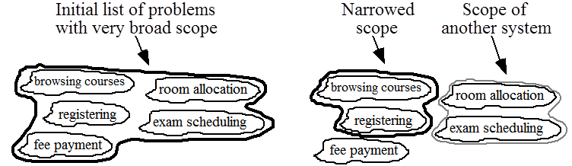
Problem scope
Narrow the scope by defining a more precise problem
  List all the things you might imagine the system doing
    Exclude some of these things if too broad
    Combine those that have reasons to work together (or should go together)
    Determine high-level goals if too narrow (summary goals)
Example – university registration system

Slide 17
Defining requirements
What is a requirement?
It is a statement describing either
      an aspect of what the proposed system must do or
      a constraint on the system’s development.
  In either case it must contribute in some way towards adequately solving the customer’s problem;
  the set of requirements as a whole represents a negotiated agreement among the stakeholders.
A collection of requirements is called a requirements document.
  All documents should be:
    sufficiently complete
    well organized
    clear and legible
    agreed to by all the stakeholders

Slide 18
Types of requirements
Functional requirements
  Describe what the system should do. Examples
      What input/outputs the system should accept/produce
      What data the system should store that other systems might use
      What computations the system should perform
      The timing and synchronization of the above
Quality requirements
  Constraints on the design to meet specified levels of quality. Examples incl constraints on response time, throughput, resource usage, availability, recoverability etc.
Platform requirements
  Constraints on the environment and technology of the system
Process requirements
  Constraints on the project plan and development methods

Slide 19
Gathering requirements
Various methods can be used to gather requirements
Observation
  Read documents and discuss requirements with users
  Shadowing important potential users as they do their work - ask the user to explain everything he or she is doing
  Session videotaping
Interviewing
  Conduct a series of interviews to
      Ask about specific details
      Ask about the stakeholder’s vision for the future
      Ask if they have alternative ideas
      Ask for other sources of information
      Ask them to draw diagrams

Slide 20
Brainstorming
    Appoint an experienced moderator
    Arrange the attendees around a table
    Decide on a ‘trigger question’
    Ask each participant to write an answer and pass the paper to its neighbour to evaluate
    Joint Application Development (JAD) is a technique based on intensive brainstorming sessions

Slide 21
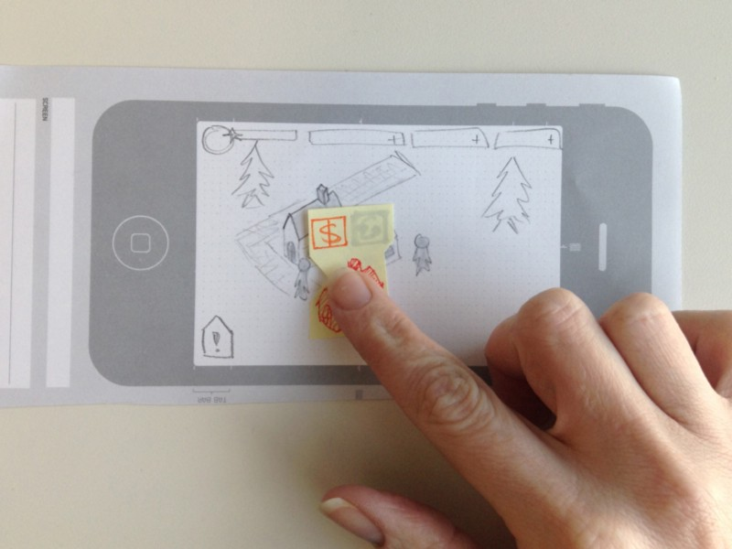
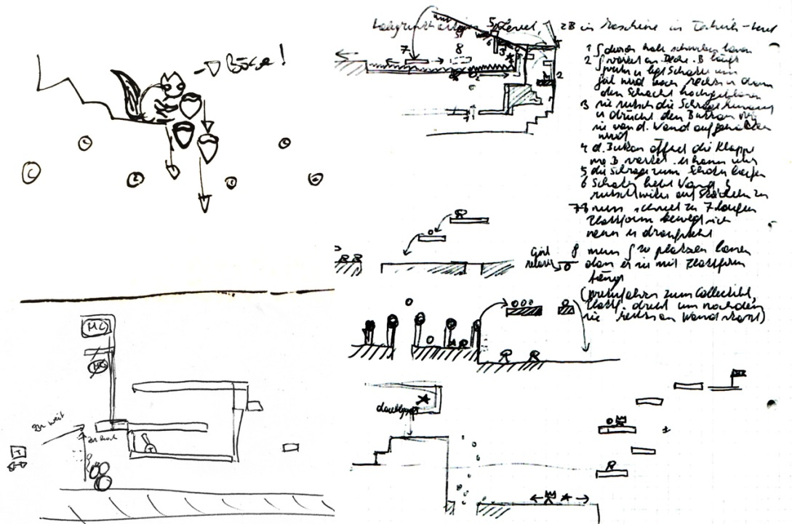
Prototyping
    The simplest kind: paper prototype - a set of pictures of the system that are shown to users in sequence to explain what would happen
    The most common: a mock-up of the system’s UI written in a rapid prototyping language
    Does not normally perform any computations, access any databases or interact with any other systems
    May prototype a particular aspect of the system

Slide 22
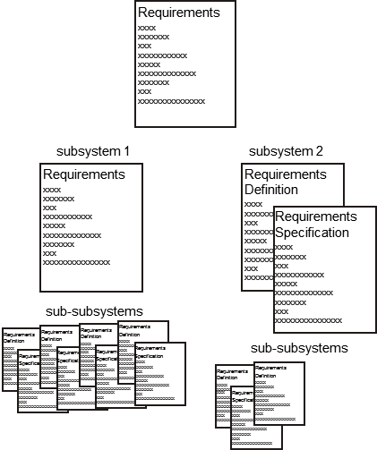
Types of requirements document
    Requirements definition
    An informal outline of the requirements
    using a few paragraphs or simple
    diagrams
    Requirements specification
    A long list of specifications that
    contain thousands of pages
    of intricate detail
  Requirements documents for
  large systems are normally
  arranged in a hierarchy

Slide 23
Depicting/Presenting requirements
Depicting a requirement means showing, presenting, or expressing the requirement clearly
Requirements determined in a project can be represented in the requirement documents in various ways
  Written form
  Mathematical form (esp. for algorithms)
  Graphical form – UML
  Models/prototypes
UML diagrams for representing requirements will be covered in detail in a later lecture.

Slide 24
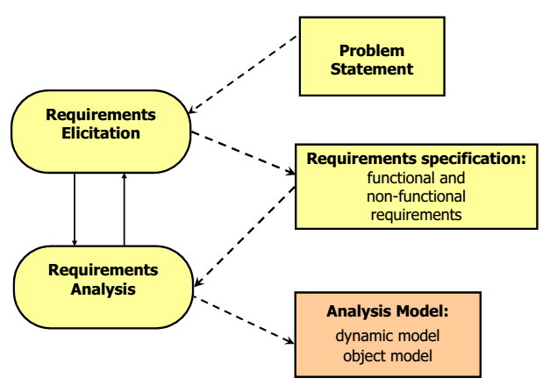
Requirements to Analysis models
Requirements analysis takes the results of domain analysis (requirement documents) to create models to better represent the domain in a programmatic manner

Slide 25
Analysis models
Analysis Object Model (AOM)
  System from the user’s perspective
  Classes and Objects (User-Level Concepts, no software classes!)
  Attributes
  Operations
  Associations
  can serve as visual dictionary of application domain
Dynamic Model
  Models the behavior of the system
  Responsibilities of classes, Flow of Control
  In general using
  Statechart Diagram
  Sequence diagram

Slide 26
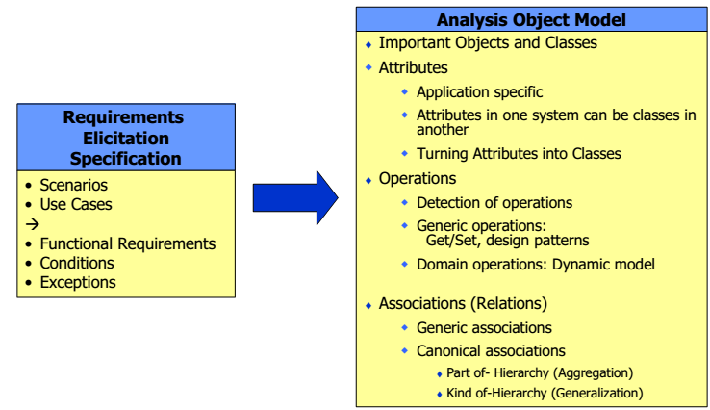
Creating the Analysis object model

Slide 27
Steps to analysis
Formulate a few scenarios with help from the end user and/or application domain expert
Extract the use cases from the scenarios, with the help of application domain expert
Analyze the flow of events
Generate the class diagrams, which includes the following steps:
  Class identification (textual analysis, domain experts) across all Use Cases (sharing of classes and objects)
  Identification of attributes and operations (sometimes before the classes are found!)
  Identification of associations between classes
  Identification of multiplicities
  Identification of roles
  Identification of constraints

Slide 28
Class Identification
Identify and describe all important entities in the system
Steps during object modeling
  Class identification – identifying objects important to the sys
  Find the attributes and methods
  Find the associations between classes
Iterate and correct the model (after reanalysis/checking)
Objects are not just found by taking a picture of a scene or domain - the application domain has to be analyzed
Depending on the purpose of the system different objects might be found
How can we identify the purpose of a system? Take the Scenarios and use cases as foundation!
Another important issue – define system boundary → what objects are inside and what objects are outside the system?

Slide 29
Object models are represented with the object diagram – a graphical notation for modeling objects, classes and their relationships
Two types
  Class diagram
    Template for describing many instances of data
    Useful for taxonomies, patterns, schema...
  Instance diagram
    A particular set of objects relating to each other.
    Useful for discussing scenarios, test cases and examples – also for evaluation running states in test systems
OO Class diagrams are covered in detail later.

Slide 30
Identifying participating objects
Pick a use case and look at its flow of events
Find terms that developers or users need to clarify in order to understand the flow of events
Look for recurring nouns (e.g., Incident, Account),
Identify real world entities that the system needs to keep track of (e.g., FieldOfficer, Dispatcher, Resource),
Identify real world procedures that the system needs to keep track of (e.g., EmergencyOperationsPlan),
Identify data sources or sinks (e.g., Printer)
Be prepared that some objects are still missing and need to be found:
Model the flow of events with a sequence diagram (later..)
Always use the user’s terms (i.e. based on domain)

Slide 31
Example
The customer enters the store to buy a toy
It has to be a toy that his daughter likes and it must cost less than 50 Ringgit.
An assistant helps him and mentions that the suitability of a toy depends on the age of the child.
The customer’s daughter is 10 years old
The assistant recommends one type of toy, namely a dress-up doll. For this game, the players must be older than 7.
The assistant also suggests a game collection which is also a toy that consists of many separate games like chess and card-games.
For this collection, the players must be older than 5
Based on source: Object-Oriented Software Engineering Using UML, Patterns, and Java

Slide 32
Overview of analysis
Identified item | Grammatical construct | UML Component
“Doll” “Game collection”, “customer” | Proper noun Common noun | Object instance Class
“10 year old”, “50 Ringgit” | Adjective | Attribute
“enter” “recommends” “suggests” | Verb | Method
“type of” | Classifier | Inheritance
“Consists of” | Having verb | Aggregation
“less than” “must be” | Modal verb | Constraints

Slide 33
Analysis Object model
Draft Class Diagram
Customer
age
getAge(); getMaxBudget();
Toys
minAge
checkAge(); buy();
Doll
Game collection
Store
branchname
enterStore();
Barbie
Chess
Cards

Slide 34
Draft Object (instance) Diagram
Mike: Customer
age = 10
getAge(); getMaxBudget();
Barbie:Toys
minAge = 8
checkAge(); buy();
Toy’sRUs:Store
branchname
enterStore();

Slide 35
Object types
Identified objects in requirement analysis can be partitioned into three types
  Entity Objects
  Boundary Objects
  Control Objects
Having three types of objects leads to models that are more adaptable to change – e,g, The interface of a system changes more likely than the control so only the boundary objects are affected.
Standard UML does not distinguish among these types

Slide 36
Entity objects
Entity objects represent real-world things in the system that have data (attributes) and a unique identity.
Represents persistent or long-lived information tracked by the system
Real-World entities from application domain (FieldOfficer, Customer)
Real-World activities the system needs to track (Order, EmergencyPlan)
Recurring Nouns that are used in the UCs
Entity Object | Why it is an Entity
Book | Has data such as title, author, ISBN, status
Member | Has ID, name, email, contact
Loan | Stores issue date, due date, return date
Librarian | Represents staff with ID and name
Fine | Stores amount, reason, payment status

Slide 37
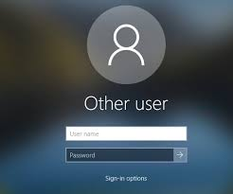
Boundary objects
Represent the interaction between the user and the system
Closely related to objects at the system boundary
Represent the system interface for the actors
Forms, Messages, Terminals for different users
Identify Forms the user needs to enter data into the system
Identify messages the system uses to respond to theuser
Also represent interface for external systems (e.g.online payment)
Described in End User Terms
  Good: EmergencyReportForm, ReportButton
  Bad: MenuItem, ScrollBar (too detailed)

Slide 38
Control objects
Control objects handle the flow of the use case.
They coordinate interactions between boundary objects (UI) and entity objects (data).
They contain the logic that controls the process.
Responsible for coordinating boundary and entity objects:
  Collecting information from boundary objects (e.g. key press)
  Dispatching to entity objects
  Control of distributed systems
Usually requires one (1) control object per use case with the life span of the object lasting the entire extent of the use case session.

Slide 39
Analysis Object model
Extension to existing class diagram
<<entity>> Customer
age
getAge(); getMaxBudget();
<<entity>> Toys
minAge
checkAge(); buy();
<<entity>> Doll
<<entity>> Game collection
<<boundary>> Store
branchname
enterStore();
<<entity>> Barbie
<<entity>> Chess
<<entity>> Cards

Slide 40
Analysis Object model
Extension to existing class diagram
<<entity>> Customer
age
getAge(); getMaxBudget();
<<entity>> Toys
minAge
checkAge(); buy();
<<boundary>> Store
branchname
enterStore();
<<entity>> Doll
<<entity>> Game collection
<<control>> SalesTransaction
amount salesPerson
create()
<<entity>> Barbie
<<entity>> Chess
<<entity>> Cards

Slide 41
Common problems
Do not defer important decisions
Don’t insist on finding all objects
Don’t be too detailed
  More details are added during object design phase
Requirements are still incomplete
  Check list (later)
  Requirements validation (later)
Feedback with Stakeholder still valuable

Slide 42
Dynamic models
Modeling of behavioral aspects among the participating objects
Tie use cases with objects
  Shows how the behavior of a use case (or scenario) is distributed among its participating objects
  Identify new objects and classes
  Helps to determine how decentralized the system is.
Purpose:
  Detect and supply methods for the object model
How do we do this?
  Start with use case or scenario
  Model interaction between objects - sequence diagram, CRC
  Model dynamic behavior of a single object - state chart diagram

Slide 43
Dynamic modeling with UML
Includes:
  Sequence Diagram
    Can be read out of use cases
    Dynamic behavior of a set of objects arranged against a time sequence
    Good for real-time specifications and complex scenarios
    Information of the life time of objects
    Also show relationships between objects methods
  State Chart Diagram
    describes the dynamic behavior of a single object
    A state machine that describes the response of an object of a given class to the receipt of outside stimuli (Events)

Slide 44
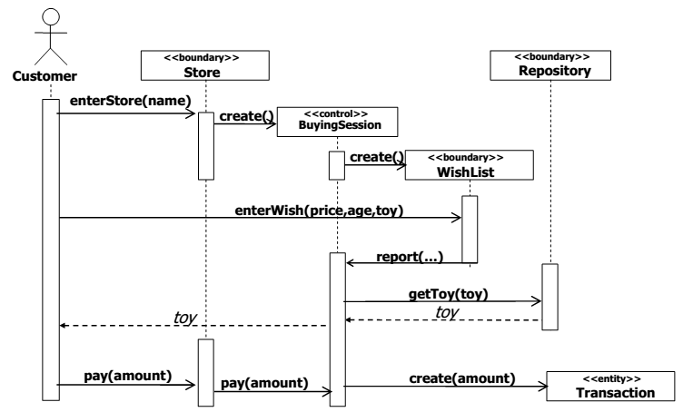
Sequence Diagram Example
Sequence diagrams will be covered in detail later

Slide 45
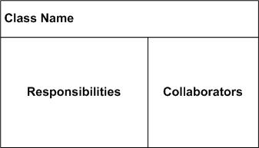
CRC
CRC Cards are valuable tools in OO to represent Classes, Responsibilites and Collaborators using cards
One card represents one class with the name written at the top of the card
Each class has a limited set of well defined responsibilities written on the left column
The CRC Card also lists the collaborators of each class on the right column
The attributes of a class can be recorded at the back of the CRC card.
Using a card helps to limit the number
of methods (responsibilities) and
collaborators a class can have to
keep a class’ design at a minimum

Slide 46
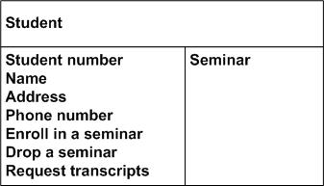
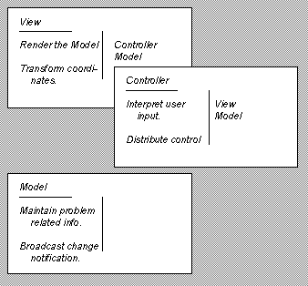
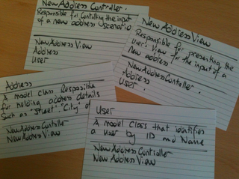

Slide 47
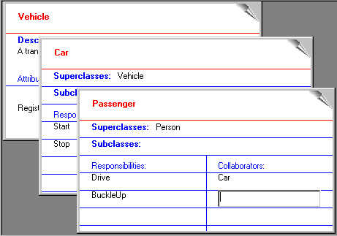
Class Name:
Superclasses:
Subclasses:
Responsibilities | Collaborators

Slide 48
Common class design flaws
Classes with too much responsibilities/no responsibility
Classes with unused responsibility
Misleading names
Unconnected responsibilities
Inappropriate use of inheritance
Repeated functionality

Slide 49
Tips in dynamic modeling
It is not necessary (and sometimes impossible) to construct the dynamic model for the entire problem domain.
Construct dynamic models only for classes with significant dynamic behavior – e.g. those that require specific flow of operations or sequence
Consider only relevant attributes - Use abstraction wherever Possible
Look at the granularity of the application when deciding on actions and activities (e.g. is “Perform sales transaction” better than “Take item”, “Scan item barcode”, “Retrieve relevant item price”, “Add to total” , “repeat”)

Slide 50
Risks in domain/req. analysis
Lack of understanding of the domain or the real problem
  Do domain analysis and prototyping
Requirements change rapidly
  Perform incremental development, build flexibility into the design, do regular reviews
Attempting to do too much
  Document the problem boundaries at an early stage, carefully estimate the time
It may be hard to reconcile conflicting sets of requirements from multiple sources
  Brainstorming, Joint Application Development (JAD) sessions, competing prototypes
It is hard to state requirements precisely
  Break requirements down into simple sentences and review them carefully, look for potential ambiguity, make early prototypes

Slide 51
Summary
What is the structure of the system?
  Create class diagrams
    Identify objects.
    What are the associations between them? What is their multiplicity? What are the attributes of the objects? What operations are defined on the objects?
What is its behavior?
  Create sequence diagrams
    Identify senders and receivers
    Show sequence of events exchanged between objects.
    Identify event dependencies and event concurrency.
  Create state diagrams
    Only for the dynamically interesting objects.

